Slide 1
Convolution-Free Medical Image Segmentation using Transformers
Ajou Univ. software dep. 201920723 김동욱
Kim Dong Wook

Slide 2
Transformer ?
RNN with attention(seq2seq with attention)
This is SLOW
Start
Score 1
Score 2
Score 3
Context
vector
Output 1
Output 2
Output 3
Input 1
Input 2
Input 3

Slide 3
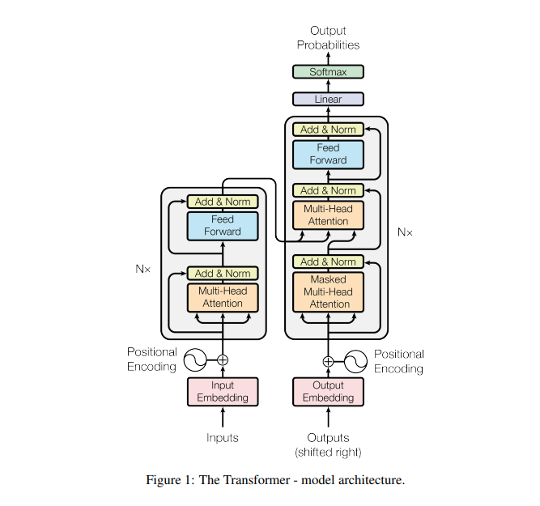
Transformer?
NO RNN, only attention
Use positional encoding

Slide 4
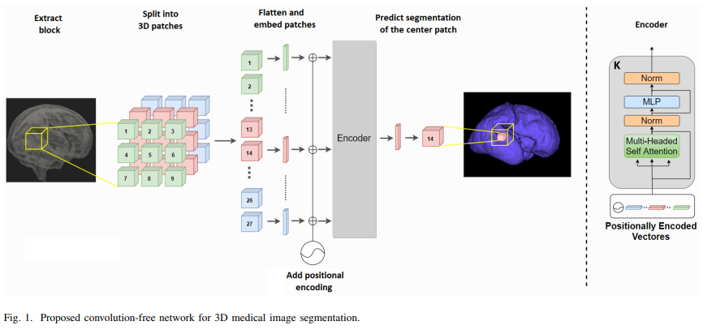
model

